Slide 1

FUNDAMENTALS OF MANAGEMENT(MG301)

Slide 2
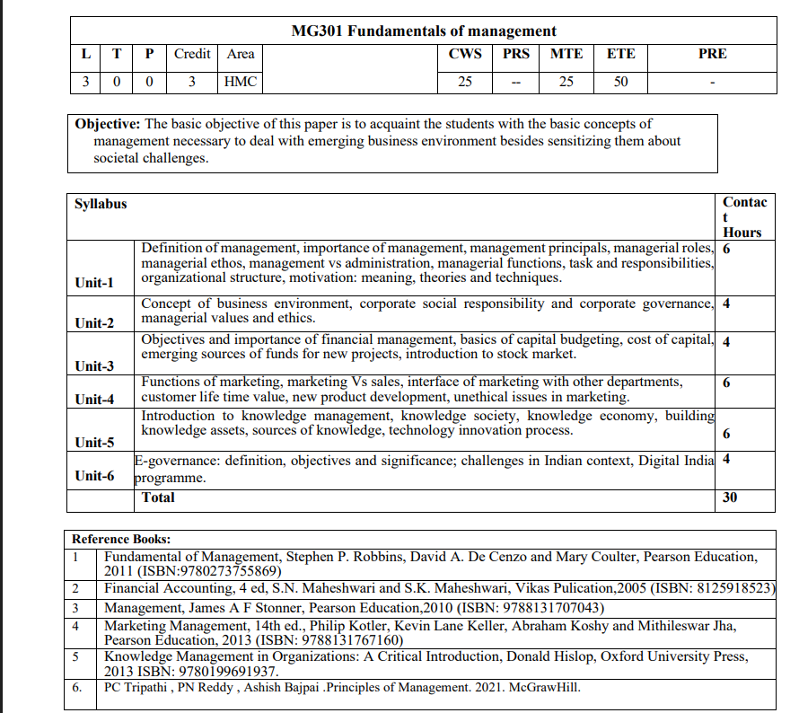
SYLLABUS

Slide 3
UNIT-I
Topics To Be Covered:-
Management- Definition, Importance
Management Principles (Fayol's 14 principles)
Managerial Role & Ethos
Management Vs Administration
Managerial Functions
Managerial Tasks & Responsibilities
Organisational Structure
Motivation
Theories of Motivation
Techniques of Motivation

Slide 4
WHAT IS MANAGEMENT?
According to Frederick Winslow Taylor (1856-1915), “management is the art of knowing what you want to do and then seeing that you do it in the best and the cheapest way.“
Definition of management according to Harold Koontz (1909-1984), “management is the art of getting things done through others and with formally organised groups.
Peter Ferdinand Drucker (1909-2005) “Management may be defined as the process by means of which the purpose and objectives of a particular human group are determined, clarified, and effectuated.
One popular definition of management by Mary Parker Follett (1868-1933). “Management is the art of getting things done through people.”
Henri Fayol (1841-1925) – “Management is to forecast, to plan, to organise, to command, to coordinate and control activities of others.”

Slide 5
Management is how businesses organise and direct workflow, operations, and employees to meet company goals.
The primary goal of management is to create an environment that allows employees to work efficiently and productively.
As a manager, you may be responsible for doing any of the following tasks:
Create goals and objectives
Create schedules
Develop strategies to increase performance, productivity, and efficiency
Ensure compliance with company policies and industry regulations
Mentor employees
Monitor budgets, productivity levels, and performance
Resolve customer problems
Train staff

Slide 6
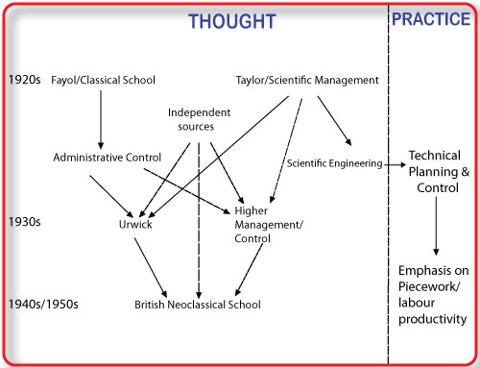
Evolution Of Management Thoughts
1. Classical Approach (1900–1930s)
Focus: Efficiency, structure, rules.
Scientific Management (F.W. Taylor): Time & motion study, standardization, productivity.
Administrative Theory (Henri Fayol): 14 principles of management.
Bureaucratic Theory (Max Weber): Formal rules, hierarchy, clear authority.
2. Neo-Classical Approach (1930s–1950s)
Focus: Human relations, motivation, teamwork.
Elton Mayo’s Hawthorne Studies: Importance of social factors, morale, and communication.Stressed employee needs, leadership, and informal groups.
3. Modern Approach (1950s onwards)
Focus: Integration of people, technology, and environment.
Systems Theory: Organization as an open system interacting with environment.
Contingency Theory: “No one best way” – management depends on situation.
Quantitative/Management Science: Use of mathematics, statistics, decision models.

Slide 7
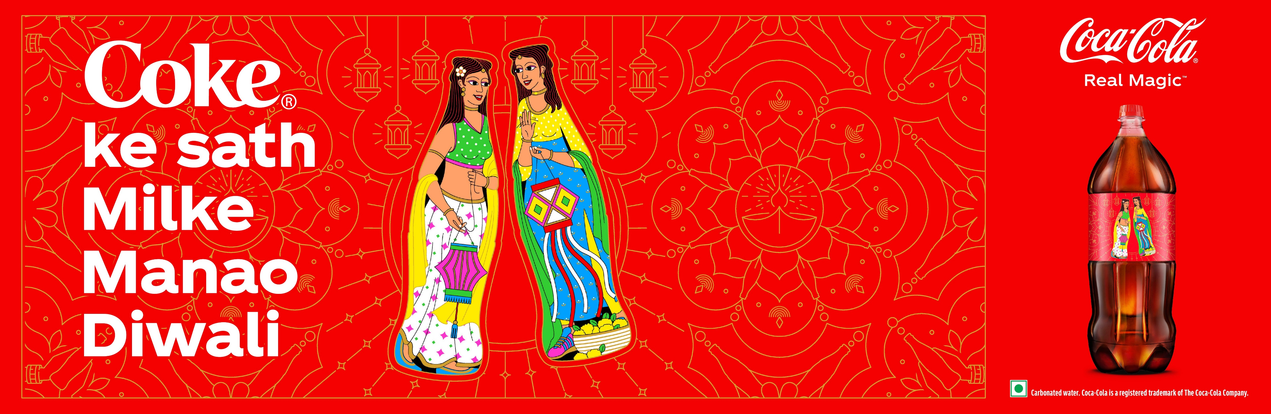
Case Study :Importance of Management Coca-Cola India
Initial Failure (1990s): (Due to mismanagement)
Coca-Cola re-entered India in 1993 after economic liberalisation.
Applied a “one-size-fits-all” global strategy without adapting to Indian consumers.
High pricing and lack of focus on local flavours led to poor acceptance.
Result → Decline in market share; local brands like Thums Up & Maaza dominated.
Management Intervention:
Shifted to a localised strategy: acquired Indian brands (Thums Up, Maaza, Limca) instead of competing with them.
Introduced affordable pricing & smaller packs (₹5 bottles, ₹10 cans) for rural markets.
Invested heavily in supply chain & cold storage infrastructure to reach remote villages.
Built strong brand management campaigns.
Effective management transforms challenges into opportunities by aligning global vision with local needs.

Slide 8
Importance Of Management
Goal Achievement – Helps organizations set clear objectives and achieve them efficiently.
Efficient Resource Utilization – Ensures optimum use of human, financial, and material resources.
Adaptability – Enables businesses to adapt to changing market trends, technology, and competition.
Employee Motivation – Builds teamwork, boosts morale, and enhances job satisfaction.
Innovation & Growth – Encourages creative problem-solving and long-term business expansion.
Stability in Operations – Provides structure, reduces uncertainty, and ensures smooth workflow.
Better Decision-Making – Supports rational, data-driven, and timely decisions.
Customer Satisfaction – Aligns strategies to meet consumer needs effectively.
Sustainability & Ethics – Promotes responsible business practices and long-term survival.
Competitive Advantage – Strong management creates an edge over rivals in a dynamic environment.

Slide 9
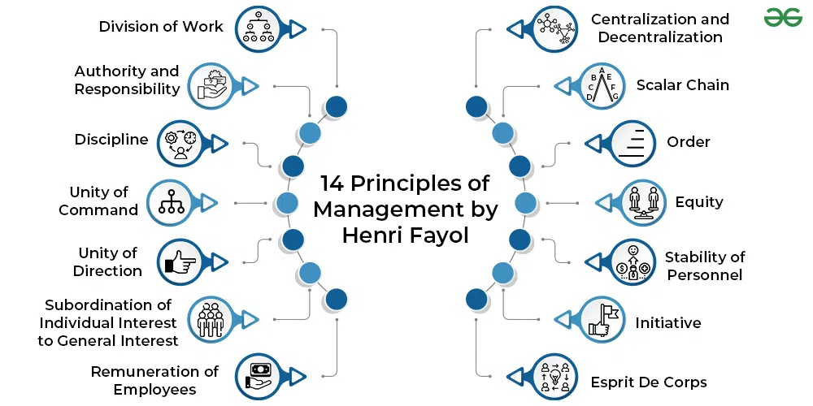
Management Principles (Fayol's 14 principles)

Slide 10
Division of Work – Specialization improves efficiency. Example: In a car plant, different teams work on engine, body, and painting separately.
Authority and Responsibility – Managers must have authority to give orders, balanced with responsibility. Example: A project manager has authority to assign tasks and is accountable for project success.
Discipline – Employees must respect rules and agreements. Example: Attendance policies in IT companies ensure punctuality.
Unity of Command – One employee should receive orders from only one superior. Example: A sales executive reports only to the sales manager, not multiple bosses.
Unity of Direction – Teams with the same goal should work under one plan and one leader. Example: A product launch team follows one marketing strategy under a single campaign manager.
Subordination of Individual Interest to General Interest – Organizational interest is above personal interest. Example: An employee prioritizes company deadlines over personal preferences.
Remuneration – Workers must be fairly paid to ensure satisfaction and motivation. Example: Infosys offers competitive salaries and performance bonuses to retain talent.

Slide 11
8. Centralization – Decision-making should be balanced between top management and employees. Example: In startups, founders make key decisions but allow team input for flexibility.
9. Scalar Chain – A clear chain of authority should exist from top to bottom. Example: A government office follows a strict hierarchy from secretary → director → manager → staff.
10. Order – People and resources must be in the right place at the right time. Example: Warehouse inventory management at Amazon ensures quick delivery.
11. Equity – Managers should treat employees with fairness and justice. Example: Tata Group ensures equal opportunities irrespective of gender or background.
12. Stability of Tenure – Job security increases efficiency and loyalty. Example: HUL invests in employee career growth to reduce attrition.
13. Initiative – Employees should be encouraged to propose and execute ideas. Example: Google’s “20% time policy” allows employees to work on personal innovative projects.
14. Esprit de Corps (Team Spirit) – Promoting teamwork leads to harmony and unity. Example: Infosys organizes team-building activities to strengthen collaboration.

Slide 12
MANAGERIAL ROLES
Mintzberg’s Management Roles is a Guideline that describes what Roles Managers tend to play on a daily basis.
These Roles were established by Henry Mintzberg in 1990.
According to Mintzberg, there are 10 main Roles that Managers usually play.
These Roles are classified into 3 different categories:
Interpersonal Roles.
Informational Roles.
Decisional Roles.

Slide 13
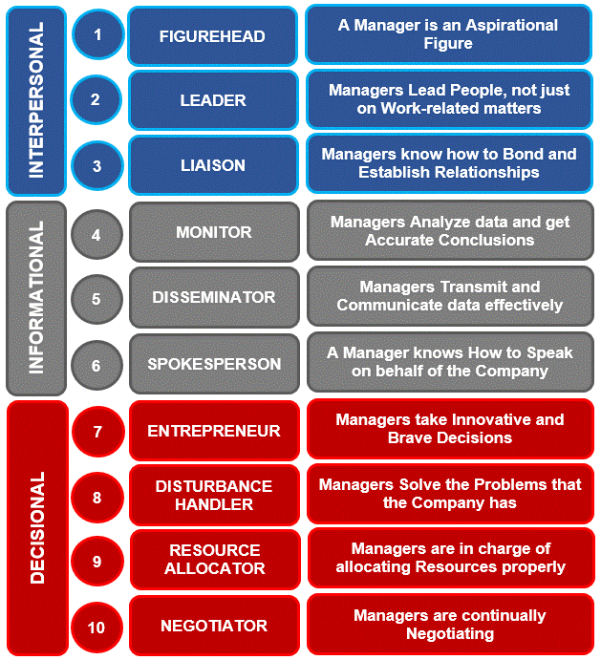

Slide 14
MANAGERIAL ETHOS
Managerial ethos refers to the values, principles, and ethical standards that guide managers in their decisions, behavior, and leadership style.
Key Elements of Managerial Ethos:
Integrity & Honesty – Being truthful and transparent in decisions.
Accountability – Taking responsibility for actions and results.
Fairness & Equity – Treating all employees and stakeholders justly.
Commitment to Excellence – Striving for efficiency, quality, and innovation.
Social Responsibility – Balancing business goals with societal good.

Slide 15
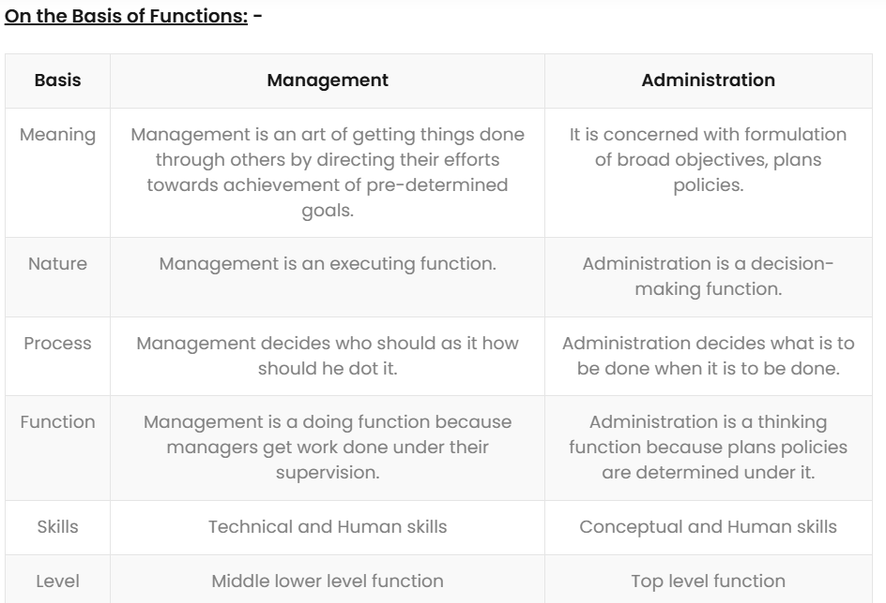
MANAGEMENT VS ADMINISTRATION

Slide 16
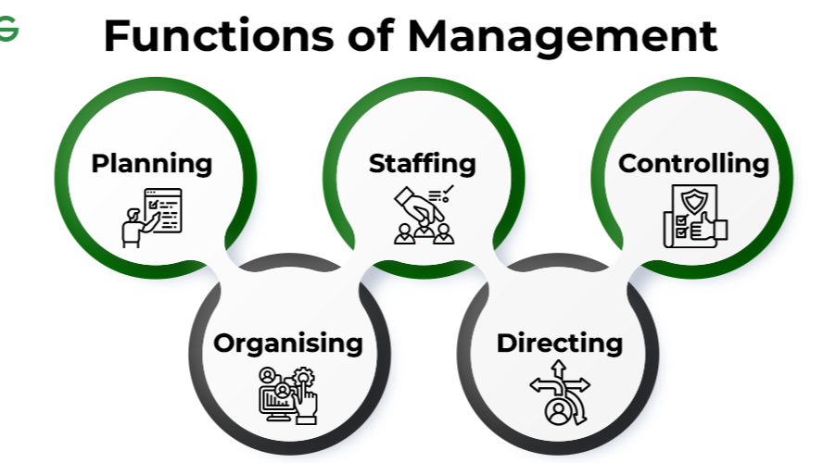
MANAGERIAL FUNCTIONS
Different experts have classified functions of management.
According to George & Jerry, “There are four fundamental functions of management i.e. planning, organizing, actuating and controlling”.
According to Henry Fayol, “To manage is to forecast and plan, to organize, to command, & to control”.
Whereas Luther Gullick has given a keyword ’POSDCORB’ where P stands for Planning, O for Organizing, S for Staffing, D for Directing, Co for Co-ordination, R for reporting & B for Budgeting.
But the most widely accepted are functions of management given by KOONTZ and O’DONNEL i.e. Planning, Organizing, Staffing, Directing and Controlling.

Slide 17
Managerial Functions (Cont..)
1. Planning
Meaning: is the purpose of ascertaining in advance what is supposed to be done and who has to do it. This signifies establishing goals in advance and promoting a way of delivering them effectively and efficiently.
Purpose: Provides direction and reduces risks.
Example: Amazon India plans seasonal sales (like Great Indian Festival) months in advance by forecasting demand, arranging stock, and planning logistics.
2. Organizing
Meaning: Arranging resources (human, financial, material) to implement the plan. Organising is the administrative operation of specifying grouping tasks, duties, authorising power and designating resources needed to carry out a particular system.
Purpose: Creates a clear structure for smooth operations.
Example: In a hospital, duties are divided among doctors, nurses, and administrative staff for efficient patient care.

Slide 18
Managerial Functions (Cont..)
3. Staffing
Meaning: Recruiting, training, and placing the right people in the right jobs.
Purpose: Builds a strong and capable workforce.
Example: Infosys hires engineers through campus drives, provides training at Mysuru campus, and allocates them to projects based on skills.
4. Directing
Meaning: Guiding, motivating, leading, and communicating with employees to achieve goals. Directing involves directing, leading and encouraging the employees to complete the tasks allocated to them. This entails building an environment that inspires employees to do their best. Motivation and leadership are 2 chief elements of direction. Directing also includes communicating efficiently as well as managing employees at the workplace.
Purpose: Converts plans into action.
Example: A sales manager motivating the team with incentives and setting monthly targets.

Slide 19
Managerial Functions (Cont..)
5. Controlling
Meaning: Monitoring performance, comparing with goals, and taking corrective action if needed. The job of controlling involves ascertaining performance criteria, computing the current performance, comparing it with established rules, and taking remedial action where any divergence is observed. Here management should ascertain what activities and outputs are important to progress, how and where they can be regulated and who should have the power to take remedial response.
Purpose: Ensures goals are achieved as planned.
Example: HUL reviews monthly sales data; if a product underperforms, they adjust marketing or distribution strategies.
Modern Expanded Functions (sometimes added):
Coordinating – Ensuring different departments work in harmony. Example: In film production, direction, editing, marketing, and finance teams work together to release a movie on time.
Reporting – Keeping stakeholders informed about progress and results. Example: Managers at Reliance Jio prepare monthly performance reports for leadership.
Budgeting – Allocating financial resources wisely. Example: Startups plan yearly budgets to balance R&D, salaries, and marketing.

Slide 20
Managerial Task-Case Study
Company Example: Amazon India – Festival Sales
During the Great Indian Festival, Amazon India faced multiple challenges as customer demand surged beyond expectations. Within the first two days, millions of orders flooded the system, leading to website slowdowns and frequent stock-outs of popular products like smartphones and electronics. Delivery networks struggled to cope with the sudden spike, especially in Tier-2 and Tier-3 cities, which led to delays and cancellations. The existing workforce was not enough to handle packaging, shipments, and the flood of customer queries. Complaints quickly spread on social media, while internal teams such as logistics, warehouses, and customer service struggled with poor coordination. The pressure grew even further because rival platforms like Flipkart were running similar mega sales, making it crucial for Amazon to deliver a flawless experience.
Act as a manager and apply all managerial functions(tasks) to solve this issue?

Slide 21
Solution Of Case Study
Managerial Tasks Applied:
Planning – Forecasted demand using AI, set sales targets, and prepared backup logistics plans.
Organizing – Allocated extra warehouses, delivery hubs, and partnered with local courier services.
Staffing – Hired temporary staff and trained them quickly to handle packaging & customer service.
Directing – Managers motivated teams with incentives, ensured coordination between tech, supply chain, and customer service.
Controlling – Monitored real-time sales and delivery dashboards, took corrective steps like rerouting shipments and adding extra transport vehicles.
Outcome:
Amazon India successfully handled record-breaking orders during the festival.
Delivery time was reduced, customer satisfaction improved, and sales revenue soared.
This showed how effective managerial tasks transform challenges into success stories.
Lesson: Managerial tasks are not just theoretical — they are the backbone of every successful organizational operation

Slide 22
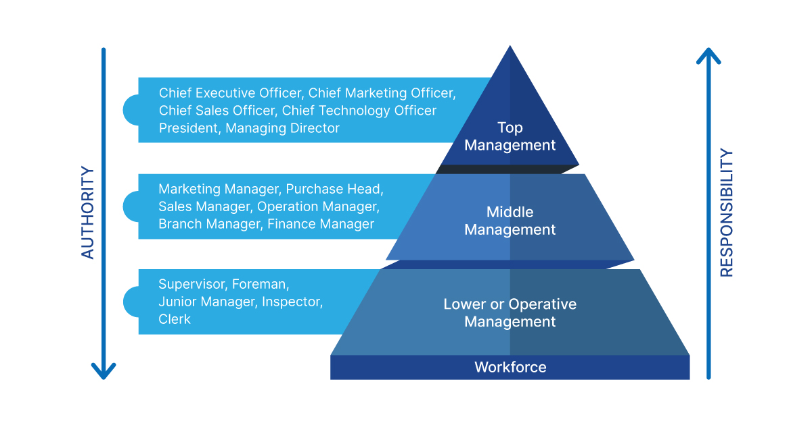
Levels of Management
The term “Levels of Management” refers to a line of demarcation between various managerial positions in an organization. The number of levels in management increases when the size of the business and work force increases and vice versa.
The level of management determines a chain of command, the amount of authority status enjoyed by any managerial position.

Slide 23
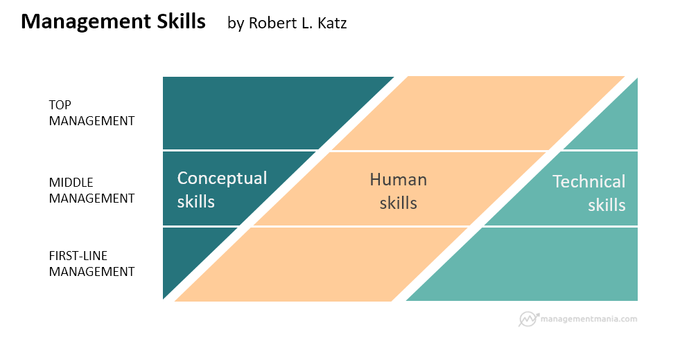
Managerial Skills
According to American social and organizational psychologist Robert Katz, the three basic types of management skills include:
1. Technical Skills
Technical skills involve skills that give the managers the ability and the knowledge to use a variety of techniques to achieve their objectives. These skills not only involve operating machines and software, production tools, and pieces of equipment but also the skills needed to boost sales, design different types of products and services, and market the services and the products.
2. Conceptual Skills
These involve the skills managers present in terms of the knowledge and ability for abstract thinking and formulating ideas. The manager is able to see an entire concept, analyze and diagnose a problem, and find creative solutions. This helps the manager to effectively predict hurdles their department or the business as a whole may face.
3. Human or Interpersonal Skills
The human or the interpersonal skills are the skills that present the managers’ ability to interact, work or relate effectively with people. These skills enable the managers to make use of human potential in the company and motivate the employees for better results.

Slide 24
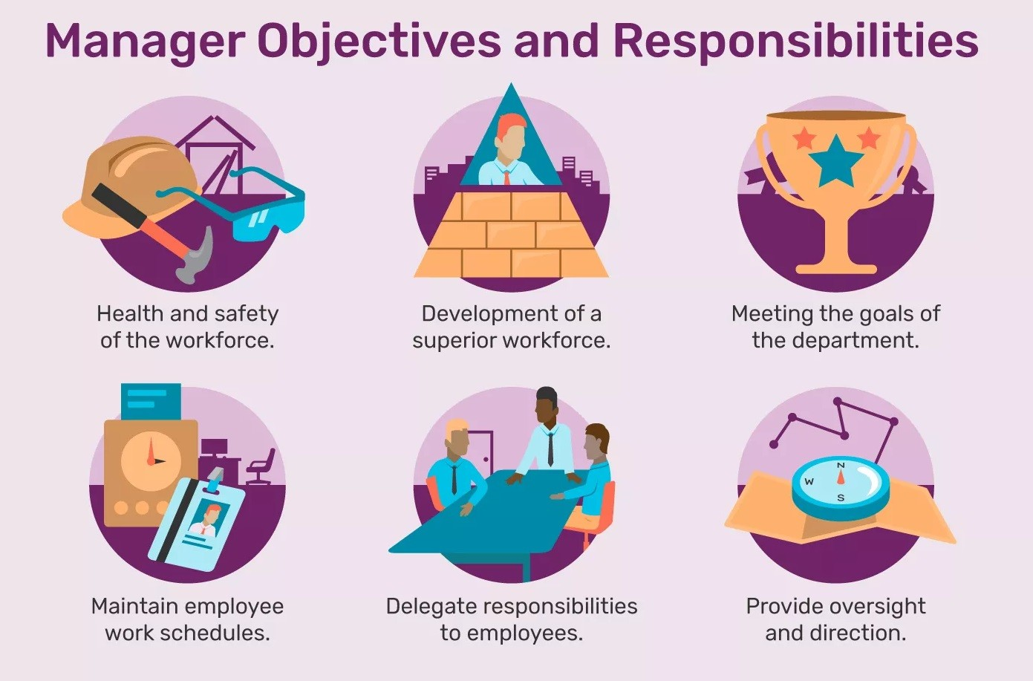
RESPONSIBILITIES OF A MANAGER
Decision-Making – Choosing the best alternatives for business problems.
Resource Management – Ensuring efficient use of manpower, money, and materials.
Conflict Resolution – Handling disputes and maintaining harmony at workplace.
Team Development – Building strong, skilled, and motivated teams.
Ethics & Compliance – Following laws, corporate values, and ethical practices.
Customer Orientation – Ensuring products/services meet customer needs.
Innovation & Change Management – Driving innovation and adapting to change.

Slide 25

ORGANISATIONAL STRUCTURE
What Is an Organizational Structure?
An organizational structure is a system that guides how certain activities are directed to achieve the goals of an organization. The organizational structure also determines how information flows between levels within the company. Decisions flow from the top down in a centralized structure. Decision-making power is distributed among various levels of the organization in a decentralized structure. Having an organizational structure in place allows companies to remain efficient and focused.

Slide 26
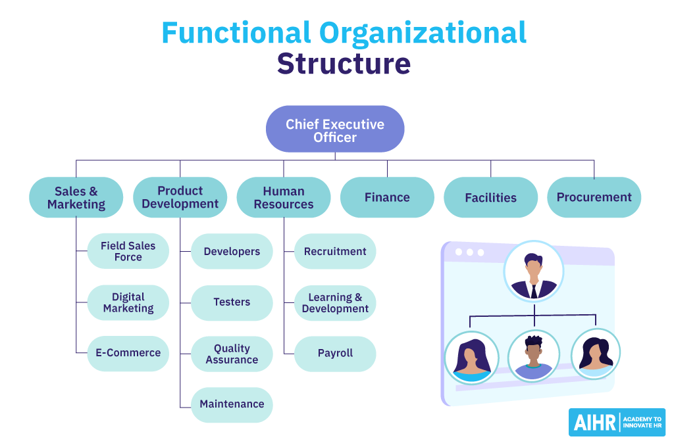
ORGANISATIONAL STRUCTURE (CONT..)
Functional Structure
Definition. The first and most common is a functional structure. It's also referred to as a bureaucratic organisational structure. It breaks up a company based on the specialization of its workforce, like HR, Finance, Marketing, Operations
Features: Clear hierarchy, specialisation, departmental efficiency.
Pros: Specialisation improves efficiency.
Clear roles and responsibilities.
Easy supervision within departments.
Cons:
Lack of coordination between departments.
Can create “silos” (departments working in isolation).
Slow decision-making in cross-functional issues.

Slide 27
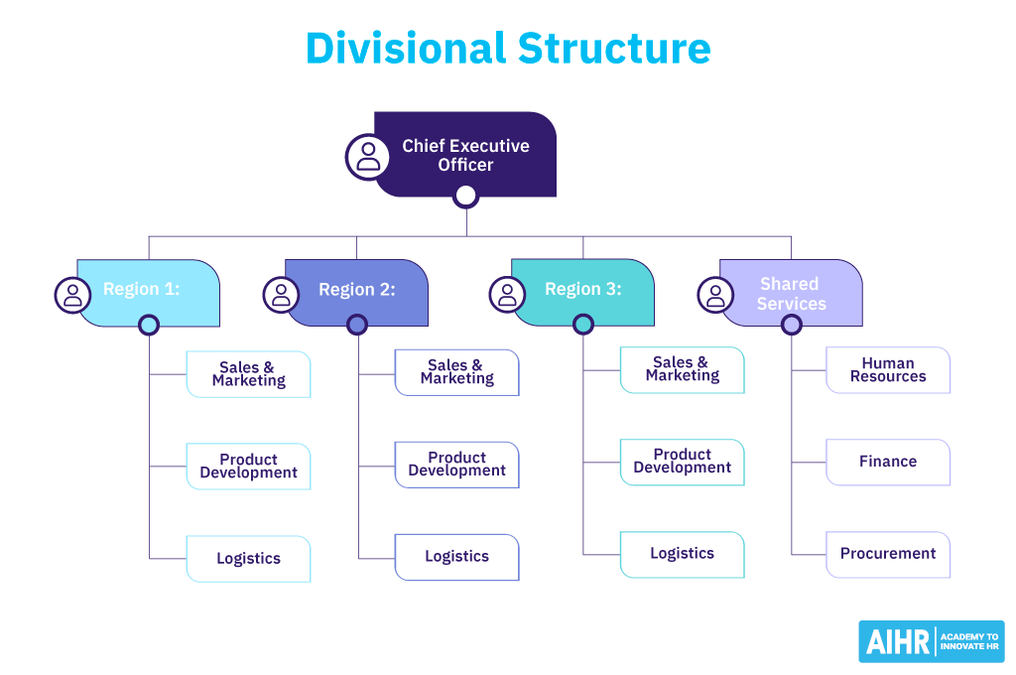
ORGANISATIONAL STRUCTURE (CONT..)
Divisional Structure
Definition: Organization is divided based on product lines, services, or geography.
Features: Each division operates as a semi-autonomous unit with its own resources.
Pros: Focus on specific products/markets.
Accountability is high at the division level.
Encourages innovation within divisions.
Cons: Duplication of resources (each division may have its own HR, Finance, etc.).
Expensive to manage.
Divisions may compete internally.
Example: Reliance Industries – Telecom (Jio), Retail.

Slide 28
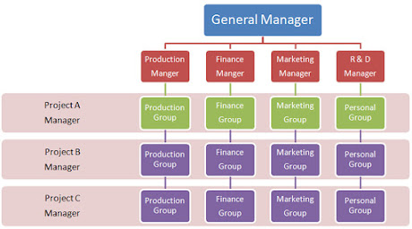
ORGANISATIONAL STRUCTURE (CONT..)
Matrix Structure
Definition: Employees report to both a functional manager and a project manager (dual authority).
Features: Combines functional specialization with project-based accountability.
Pros: Better coordination between functions.
Efficient resource utilization.
Flexible and encourages teamwork.
Cons: Confusion due to dual reporting.
Conflicts between project and functional managers.
Requires strong communication systems.
Example: L&T, NASA project teams.

Slide 29
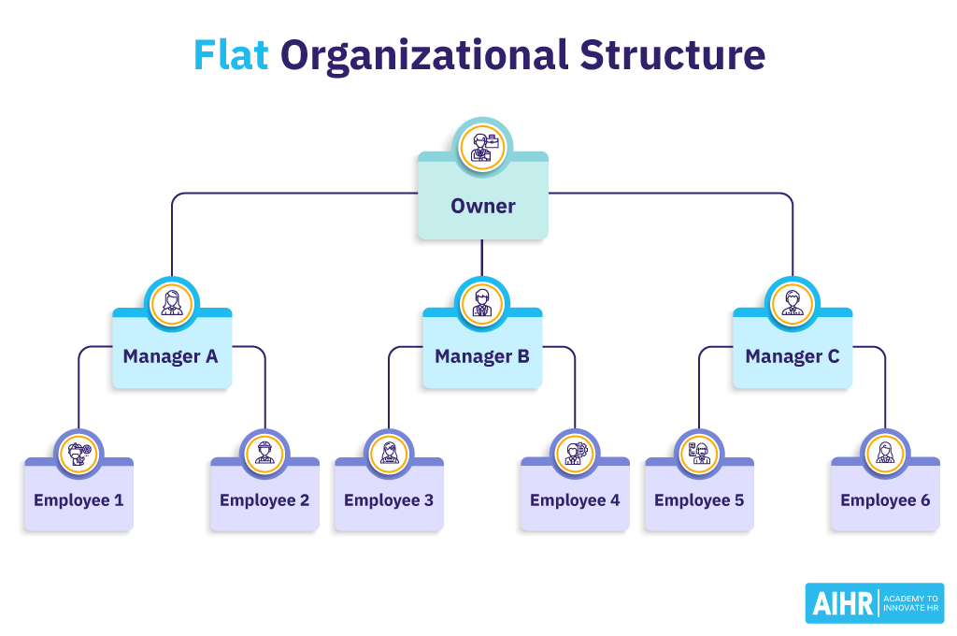
ORGANISATIONAL STRUCTURE (CONT..)
Flat Structure
Definition: Few or no levels of middle management, encouraging direct communication.
Features: Decentralized, open communication, flexible.
Pros: Quick decision-making.
Encourages innovation and employee involvement.
Cost-effective (less management overhead).
Cons: Lack of clear authority and control.
Not suitable for large organizations.
Risk of role confusion.
Example: Startups like Swiggy or Zomato in early stages.

Slide 30
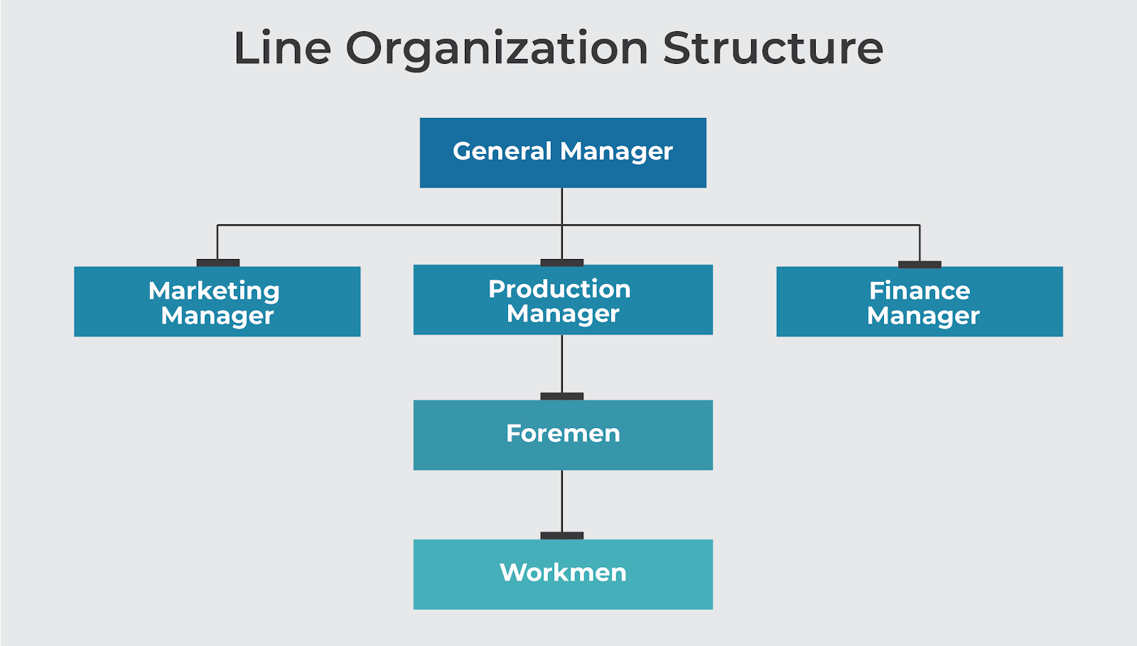
ORGANISATIONAL STRUCTURE (CONT..)
Line Structure
Definition: Authority flows directly from top to bottom in a straight line.
Features: Simple, oldest form, military-style hierarchy.
Pros: Simple to understand and implement.
Clear authority and responsibility.
Quick decision-making.
Cons: Overburden on top management.
No specialization.
Not suitable for large organizations.
Example: Small shops, family-run businesses, military.

Slide 31
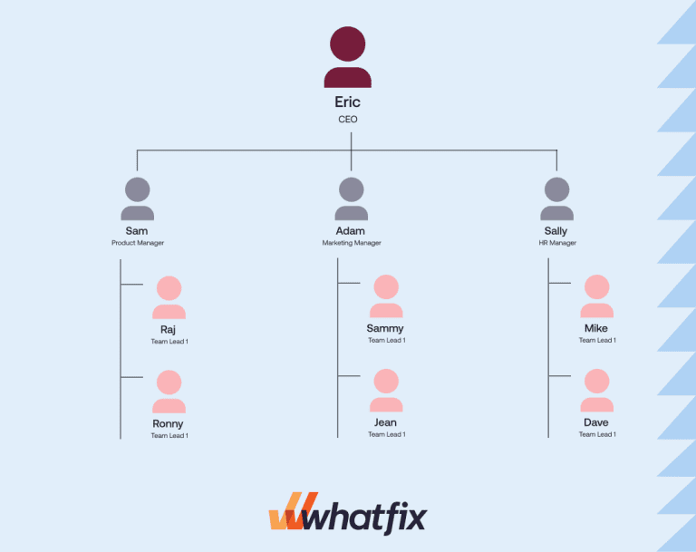
ORGANISATIONAL STRUCTURE (CONT..)
Team-Based Structure
Definition: Focuses on collaboration, employees work in cross-functional teams.
Features: Project-based, less hierarchy, high flexibility.
Pros: Encourages teamwork and innovation.
Flexible and adaptable to change.
High employee involvement.
Cons: Role ambiguity (who is in charge?).
Can slow decisions if consensus is required.
Requires strong coordination.
Example: Google’s cross-functional project teams.

Slide 32


Slide 33
Why To Study Motivation And Motivation Theories?
All organizations are concerned with what should be done to achieve sustained high levels of performance through people. This means giving close attention to how individuals can best be motivated through such means as incentives, rewards, leadership and, importantly, the work they do and the organization context within which they carry out that work.
The aim is to develop motivation processes and a work environment that will help to ensure that individuals deliver results in accordance with the expectations of management.
Motivation theory examines the process of motivation. It explains why people at work behave in the way they do in terms of their efforts and the directions they are taking.
It describes what organizations can do to encourage people to apply their efforts and abilities in ways that will further the achievement of the organization’s goals as well as satisfying their own needs. It is also concerned with job satisfaction – the factors that create it and its impact on performance.

Slide 34
MOTIVATION
What is Motivation?
A motive is a reason for doing something. Motivation is concerned with the factors that influence people to behave in certain ways.
The three components of motivation as listed by Arnold et al (1991) are:
● direction – what a person is trying to do;
● effort – how hard a person is trying;
● persistence – how long a person keeps on trying
According to Edwin B.Flippo, “Motivation is the process of attempting to influence others to do your will through the possibility of gain or reward.”
According to Dalton E. McFarland, “Motivation refers to the way in which urges, drives, desires, aspirations, strivings or needs direct, control or explain the behavior of human beings.”
According to William G. Scout, “Motivation means a process of stimulating people to action to accomplish desired goals”.

Slide 35
Types Of Motivation
Motivation at work can take place in two ways. First, people can motivate themselves by seeking, finding and carrying out work (or being given work) that satisfies their needs or at least leads them to expect that their goals will be achieved. Secondly, people can be motivated by management through such methods as pay, promotion, praise, etc.
There are two types of motivation as originally identified by Herzberg et al (1957):
● Intrinsic motivation – the self-generated factors that influence people to behave in a particular way or to move in a particular direction. These factors include responsibility (feeling that the work is important and having control over one’s own resources), autonomy (freedom to act), scope to use and develop skills and abilities, interesting and challenging work and opportunities for advancement.
● Extrinsic motivation – what is done to or for people to motivate them. This includes rewards, such as increased pay, praise, or promotion, and punishments, such as disciplinary action, withholding pay, or criticism

Slide 36
Theories of Motivation
Approaches to motivation are underpinned by motivation theory.
The most influential theories are classified as follows:
● Instrumentality theory, which states that rewards or punishments (carrots or sticks) serve as the means of ensuring that people behave or act in desired ways.
● Content theory, which focuses on the content of motivation. It states that motivation is essentially about taking action to satisfy needs, and identifies the main needs that influence behaviour. Needs theory was originated by Maslow (1954), and in their two-factor model, Herzberg et al (1957) listed needs which they termed ‘satisfiers’.
● Process theory, which focuses on the psychological processes which affect motivation, by reference to expectations (Vroom, 1964), goals (Latham and Locke, 1979) and perceptions of equity (Adams, 1965).

Slide 37
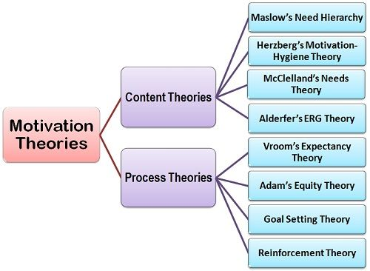
Theories of Motivation
Maslow’s Hierarchy of Needs
Employees are motivated by needs in order: physiological → safety → social → esteem → self-actualization.
Example: Google provides salaries (basic needs), job security, team culture, recognition, and opportunities for personal growth.
Herzberg’s Two-Factor Theory
Hygiene factors (salary, job security) prevent dissatisfaction.
Motivators (achievement, recognition, growth) drive true satisfaction.
Example: Infosys ensures good pay (hygiene) + career growth programs (motivators).
McGregor’s Theory X and Theory Y
Theory X: Employees dislike work and need strict control.
Theory Y: Employees are self-motivated and seek responsibility.
Example: Startups like Zomato apply Theory Y by giving employees freedom and ownership.
Vroom’s Expectancy Theory
Motivation = Expectancy × Instrumentality × Valence.
Employees work harder if they believe effort → performance → reward.
Example: Sales teams motivated by performance-based incentives.

Slide 38
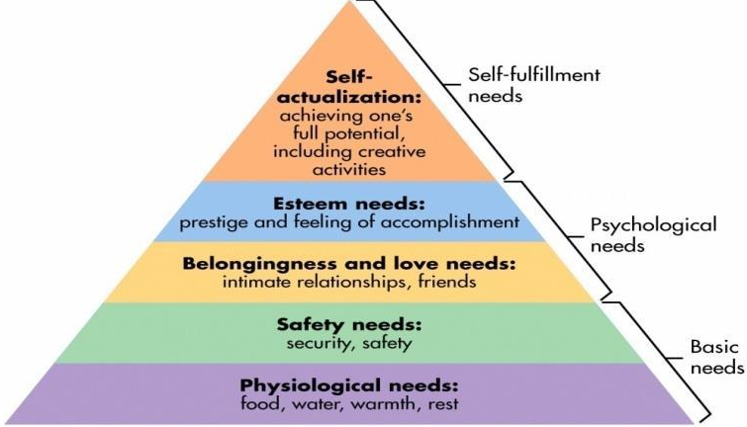
Maslow’s Need Hierarchy Theory:
This is the most well-known theory of motivation of Abraham Maslow, a clinical psychologist. A basic assumption of this model is that as we satisfy one type of need, other needs then occupy our attention. Once we satisfy our need for food, air and shelter, then we can move on to safety needs, love needs and so on.
Physiological Needs (Basic Survival Needs) These refer to physical or biological needs meant for survival and maintenance of life. Examples: Food, water, shelter, air, sleep, clothing.
Without meeting these, a person cannot focus on higher needs.
Safety Needs (Security & Protection) Once survival needs are met, people want safety and security in life.
Examples: Job security, financial stability, health care, protection from accidents or harm, safe home

Slide 39
Maslow’s Need Hierarchy Theory:
Love and Belongingness Needs (Social Needs) After the first two needs are satisfied, social needs become important in the need hierarchy. Since man is a social being , he has a need to belong and to be accepted by various groups. It includes need for acceptance, need for belonging, need for love, affection, friendship etc. As a manager, you can account for the social needs of your employees by making sure each of your employees know one another, encouraging cooperative teamwork, being an accessible and kind supervisor and promoting a good work-life balance.
Esteem Needs (Respect & Recognition) these needs are concerned with self-respect, self-confidence, a feeling of personal worth, feeling of being unique, and recognition. As a manager, you can account for the esteem needs of your employees by offering praise and recognition when the employee does well, and offering promotions and additional responsibility to reflect your belief that they are a valued employee. Examples: Confidence, achievements, status, respect, appreciation, recognition at work or society.
Self-Actualization (Growth & Fulfillment Needs) Self-actualisation is the need to maximize one’s potential whatever it may be. These needs arise only after the four categories of need are fulfilled. These needs are more like mission, lifetime aspiration Examples: Creativity, pursuing passions, personal growth, problem-solving, becoming the best version of oneself.

Slide 40
Hezberg’s Two-Factor Theory:
Frederick Herzberg proposed a two-factor theory or the motivator- hygiene theory in 1959. According to Herzberg, there are some job factors that result in satisfaction while there are other job factors that prevent dissatisfaction.
Herzberg classified these job factors into two categories-
i. Hygiene Factors: Herzberg used the term ‘hygiene’ to describe factors which are related to the conditions under which job is performed such as compensation, job security, organizational politics, working conditions, quality of leadership, and relationships between supervisors, subordinates, and peers. These factors are extrinsic to work. Hygiene factors are also called as dissatisfiers or maintenance factors as they are required to avoid dissatisfaction. Since any increase in these factors will not affect employee’s level of satisfaction, these are of no use for motivating them.
ii. Motivational Factors: According to Herzberg, the hygiene factors cannot be regarded as motivators. The motivational factors yield positive satisfaction. These factors are inherent to work. These factors motivate the employees for a superior performance. These factors are called satisfiers. These are: achievement, recognition, advancement, works itself, possibility of growth and responsibility. Most of these factors are related with job contents. Any increase in these factors will satisfy the employees; however any decrease will not affect their level of satisfaction.

Slide 41
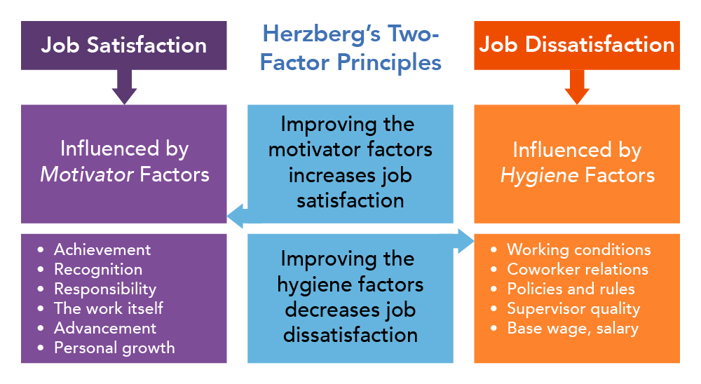

Slide 42
McClelland’s Theory of Needs:
This theory was developed by David McClleland and his associates. The theory focuses on three needs, defined as follows:
Need for achievement (nAch): it is the drive to excel, to achieve in relation to a set of standards, to strive to succeed.
McClleland has identified four basic features of high achievers: i. Always ready to take risks.
ii. provide immediate feedback
iii. accomplish the task easily on time.
iv. Preoccupied the task till its completion.
Need for Power (nPow): it is the need to manipulate others or the drive for superiority over others. People with high power need have a great concern for exercising influence and control.
Need for Affiliation (nAff): It is a need for open and sociable interpersonal relationships. In other words, it is a desire for relationship based on co-operation and mutual understanding. Such individuals are effective performers in a team. These people want to be liked by others. They prefer having friends rather than experts as work partners, and they avoid conflict whenever possible.

Slide 43
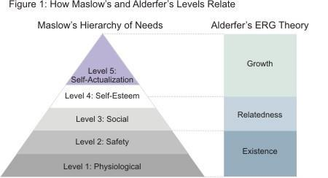
Alderfer’s ERG Theory
Clayton Paul Alderfer, an American psychologist further expanded Maslow’s hierarchy of needs by categorizing the hierarchy into his ERG theory (Existence, Relatedness and Growth). Alderfer has categorized the various needs into three categories:
Existence Needs: it consists of physiological and safety needs such as hunger ,thirst etc (Maslow’s first two levels)
Relatedness Needs: it consists of social and external esteem needs that involve relationship with other people. (Maslow’s third and fourth level).’
Growth Needs: it consists of self-actualization and internal esteem needs like feeling of being unique, feeling of personal growth etc. (Maslow’s fourth and fifth level)

Slide 44
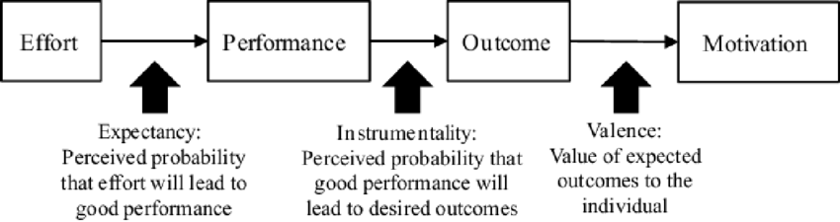
Vroom Expectancy Theory:
This theory was first proposed by Victor Vroom of the Yale School of Management in 1964. Expectancy theory says that employees will be motivated to exert a high level of effort when they believe:
That effort will lead to a good performance appraisal.
That a good appraisal will lead to organisational rewards, such as bonus, a salary increase, or a promotion; and
That the rewards will satisfy the employees’ personal goals.
Expectancy theory must focus on three things i.e. Efforts (E), Performance (P) and Outcomes (O). In order to be motivated to act or perform their job, employees must perceive that their efforts (E) are likely to lead to good performance (P). In other words, effort has to be instrumental to good performance. Second, people must expect that their performance is clearly linked to certain outcomes (O). And finally, they have to value (V) the outcome they obtain when they perform. If all these paths and linkages are clear, the person will be motivated.

Slide 45
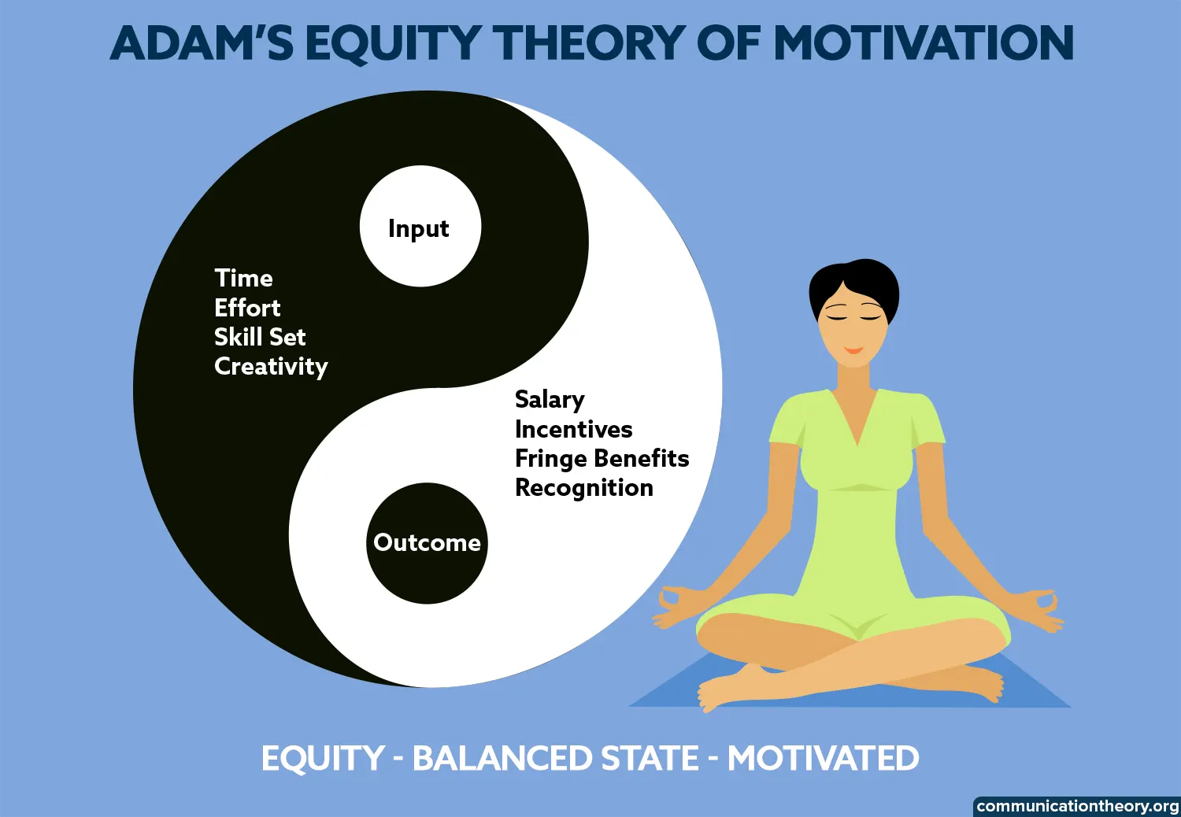
Adam's Equity Theory
Theory says that individuals evaluate the inputs they contribute to a situation and compare them to the outcomes they receive in return. When individuals perceive a fair alignment between their inputs and outcomes, equity is achieved.This perception of equity generates positive emotions, fosters job satisfaction, and motivates individuals to sustain or increase their efforts.
However, when individuals perceive an inequity, two scenarios may arise:
Underpayment inequity: This occurs when individuals feel that their inputs outweigh their outcomes in comparison to others in similar roles. They experience a sense of being under-compensated or undervalued, leading to dissatisfaction and reduced motivation.
Overpayment inequity: Conversely, individuals may feel that their outcomes exceed their inputs relative to others. While this may initially appear favourable, it can evoke feelings of guilt, discomfort.
To restore equity, individuals may engage in various behaviours. Organizations can benefit from embracing Adam's Equity Theory by fostering fairness in their reward systems, performance evaluations, and decision-making processes. Organizations can cultivate higher levels of job satisfaction, motivation, and overall well-being by promoting a sense of equity among employees.

Slide 46
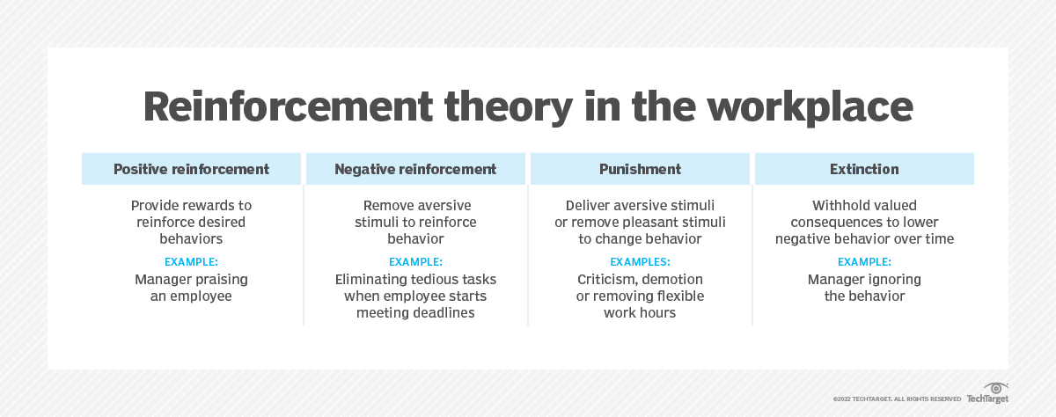
Reinforcement theory
Reinforcement theory of motivation was proposed by BF Skinner and his associates.
It states that individual’s behaviour is a function of its consequences.
It is based on “law of effect”, i.e, individual’s behaviour with positive consequences tends to be repeated, but individual’s behaviour with negative consequences tends not to be repeated.

Slide 47
Techniques Of Motivation
1.Financial incentives: First techniques of motivation are financial incentives as money is indicator of success. Therefore, it fulfills psychological safety and status need as people satisfy their needs by money. Wages, salary motivates employees to perform better.
2. Job enlargement: Under this technique, task assigned to do job are increased by adding simile task. So the scope of job enlargement is high for the motivation of subordinates. It is also known as horizontally leading of job.
3. Job enrichment: Under this technique jobs are made challenging and meaningful by increasing responsibility and growth opportunities. In such technique of motivation, planning and control responsibility are added to the job usually with less supervision and more self-evaluation. It is also called vertical leading.
4. Job rotation: It refers to shifting an employee from one job to another. Such job rotation doesn’t mean hanging of their job but only the employees are rotated. By this it helps to develop the competency in several jobs which helps in development of employees.

Slide 48
Techniques Of Motivation
5. Participation: Participation refers to involvement of employee in planning and decision-making .it helps the employees feel that they are an asset of the organization which helps in developing ideas to solve the problems.
6. Delegation of authority: Delegation of authority is concerned with the granting of authority to the subordinates which helps in developing a feeling of dedication to work in an organization because it provides the employees high morale to perform any task.
7. Quality of work life: It is the relationship between employees’ and the total working environment of organization. It integrates employee needs and well-being with improves productivity, higher job satisfaction and great employee involvement. It ensures higher level of satisfaction.
8. Management by Objectives(MBO): It is used as a motivation and technique for self-control of performance. By this technique supervisor and subordinates set individual and organizational goals. Each individual’s responsibilities are clearly defined which would help identify the skill sets one has to make the best use of the same to meet organizational mission and vision. This also helps the organization function effectively.

Slide 49
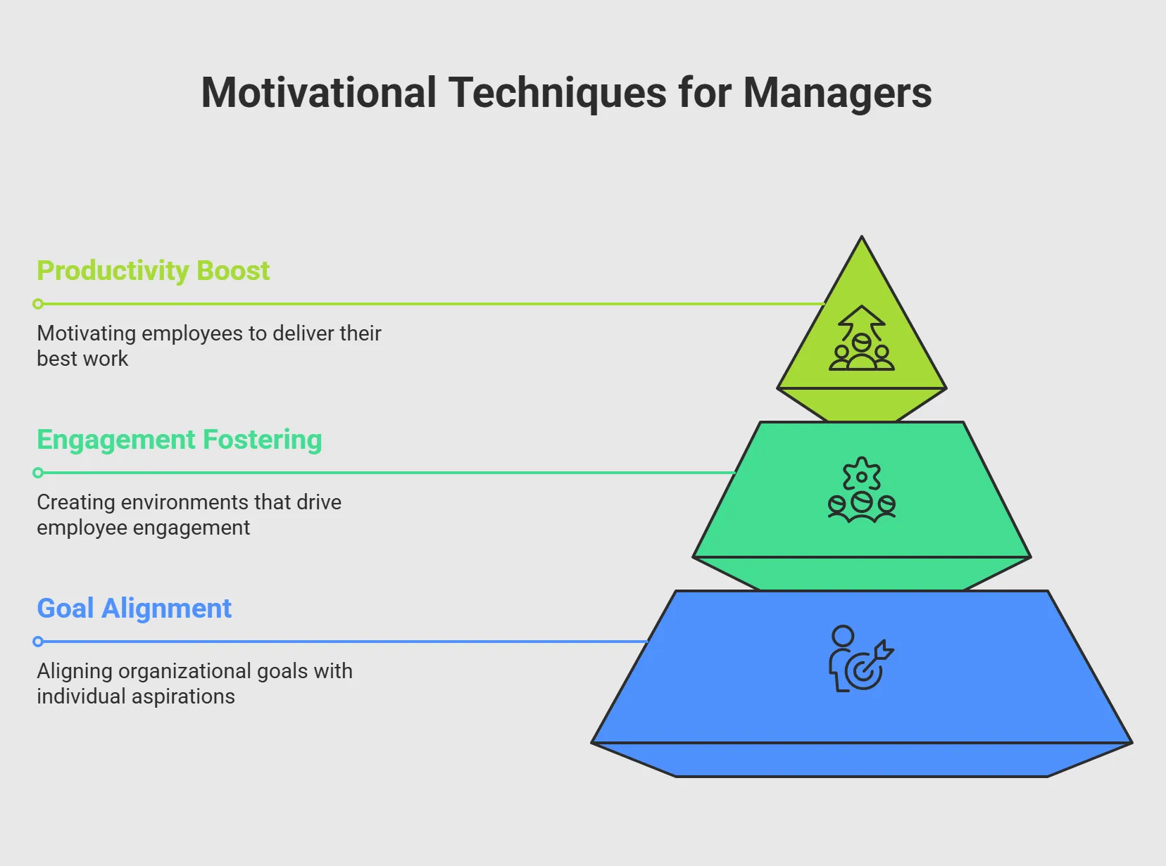
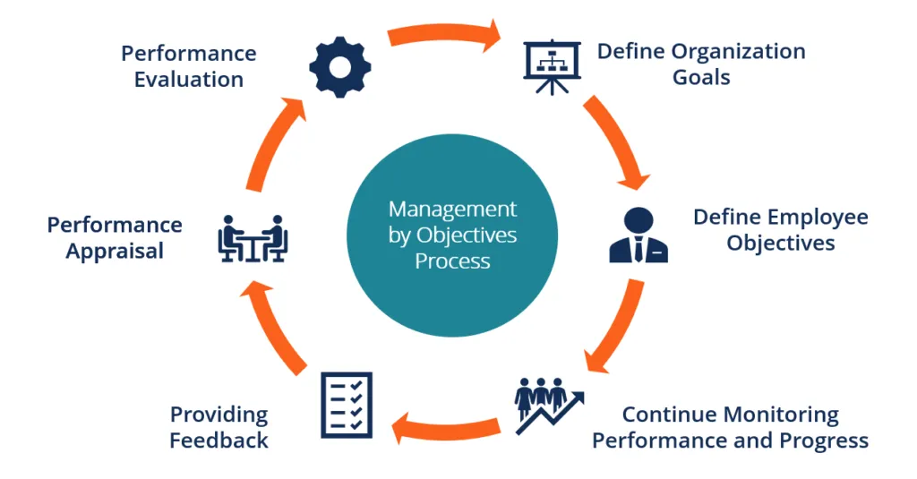
Motivational Technique

Slide 50
Books to Refer:
Fundamental of Management, Stephen P. Robbins, David A. De Cenzo and Mary Coulter, Pearson Education, 2011 (ISBN:9780273755869).
Organizational Behaviour by Timothy A. Judge Neharika Vohra Stephen P. Robbins ,Eighteenth Edition| By Pearson
Fisher, E. A. (2009). Motivation and Leadership in Social Work Management: A Review of Theories and Related Studies. Administration in Social Work, 33(4), 347–367. https://doi.org/10.1080/03643100902769160

